Slide 1
Generalized Latent Bandits (Research Intern Project Inception Talk)
Subhojyoti Mukherjee (Branislav Kveton, Anup Rao)
Adobe Research (STL/BEL) | 22-Feb-2018

Slide 2
Something about me
Current : 3rd year Computer Science M.S student at Indian Institute of Technology Madras (submitted thesis). I will be joining CS PhD at UMass Amherst, Fall 2018.
Research focus area(s): reinforcement learning, multi-armed bandits
My contact outside Adobe – subho@cse.iitm.ac.in, subhojyotimukherjee22@gmail.com
I have worked on several interesting areas in multi-armed bandits:-
Thresholding bandits with Augmented UCB (accepted at IJCAI 2017)
Efficient UCBV: An Almost Optimal Algorithm using Variance Estimates (accepted at AAAI 2018)
3-month Internship at INRIA, SequeL Lab, Lille France under Odalric-Ambrym Maillard.
Improved Changepoint Detection in Piecewise Stochastic Bandits (under review at ICML 2018).

Slide 3



Online Learning Game
At each timestep t, Nature chooses a user i_{t} (row).
The learner chooses an arm j_{t} (column).
Only the reward for the user, arm pair (i_{t}, j_{t} ) chosen is revealed to the learner.
Learner modifies its suggestion for the user i_{t} on receiving the feedback.

Slide 4


Latent Bandit Game
At each timestep t, Nature chooses a user i_{t} (row).
The learner chooses an arm j_{t} (column).
Only the reward for the user, arm pair (i_{t}, j_{t} ) chosen is revealed to the learner.
Learner modifies its suggestion for the user i_{t} on receiving the feedback.
It can learn faster if it leverages the latent structure about the groupings of users
Users are grouped into clusters, unknown to the learner

Slide 5
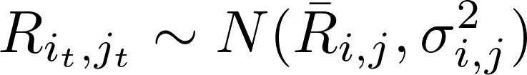
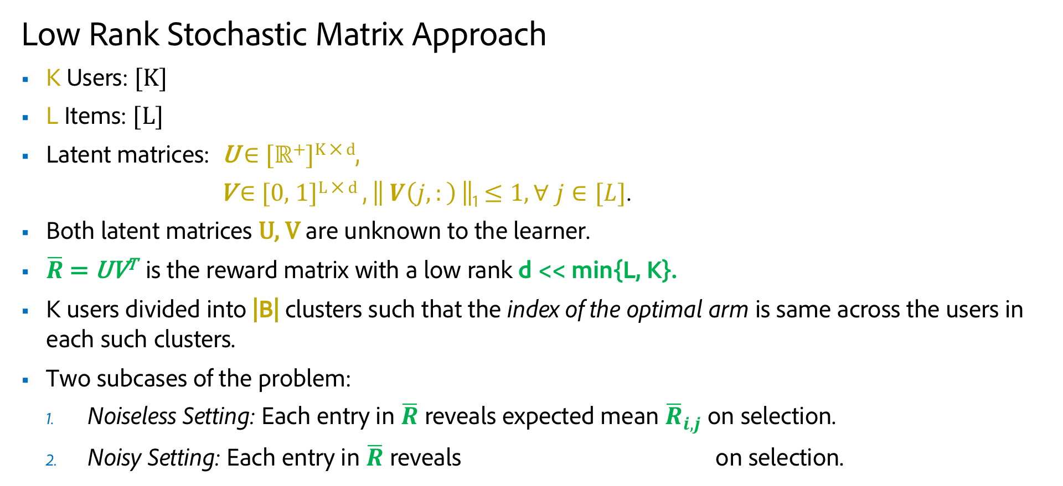
Problem Definition
Low Rank Stochastic Matrix Approach
K Users: [K]
L Items: [L]
Latent matrices: U $∈$ [ℝ⁺]^{K ⨉ d},
V $∈$ [0, 1]^{L ⨉ d} , || $V\left(j,:\right)$||₁ $≤1, ∀ j∈[L]$.
Both latent matrices U, V are unknown to the learner.
$\overline{R}$ = UV^{T} is the reward matrix with a low rank d << min{L, K}.
K users divided into |B| clusters such that the index of the optimal arm is same across the users in each such clusters.
Two subcases of the problem:
Noiseless Setting: Each entry in $\overline{R}$ reveals expected mean ${\overline{R}}_{i,j}$ on selection.
Noisy Setting: Each entry in $\overline{R}$ reveals on selection.

Slide 6
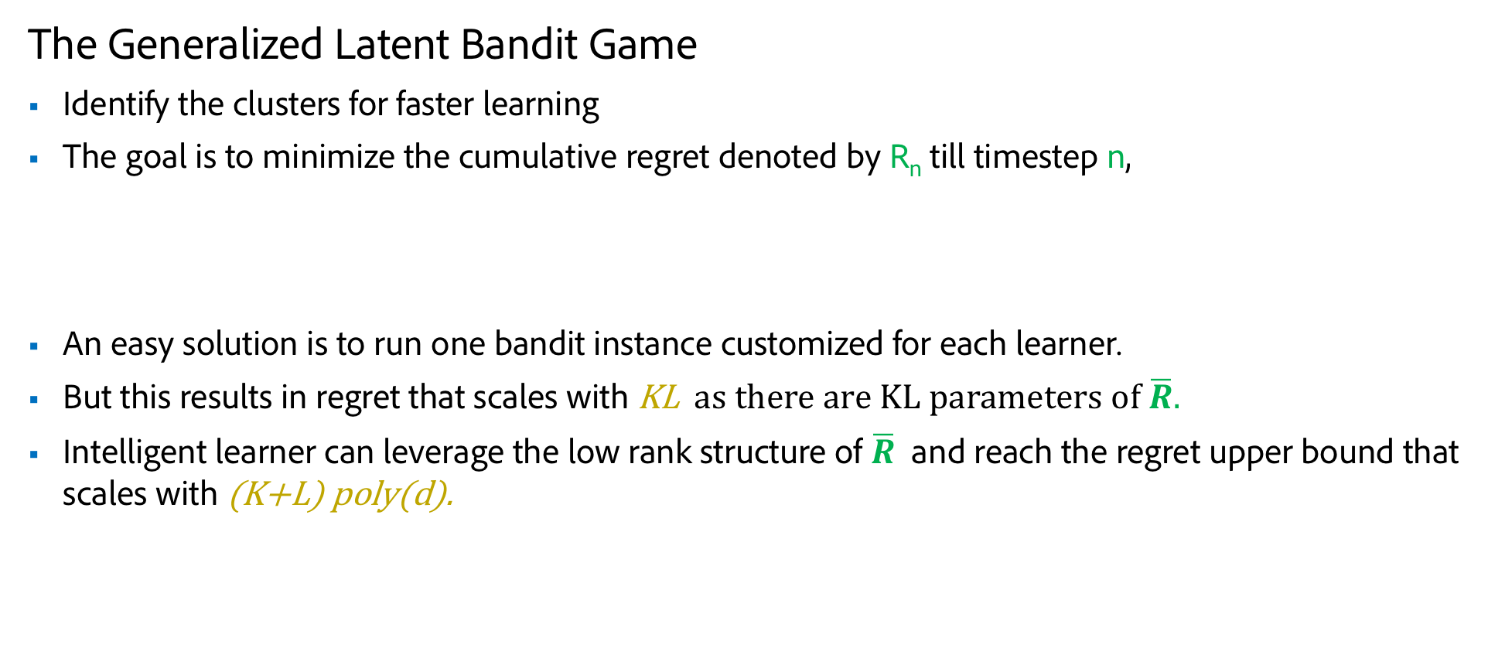
Goal of the Learner
The Generalized Latent Bandit Game
Identify the clusters for faster learning
The goal is to minimize the cumulative regret denoted by R_{n} till timestep n,
An easy solution is to run one bandit instance customized for each learner.
But this results in regret that scales with KL as there are KL parameters of $\overline{R}.$
Intelligent learner can leverage the low rank structure of $\overline{R}$ and reach the regret upper bound that scales with (K+L) poly(d).

Slide 7
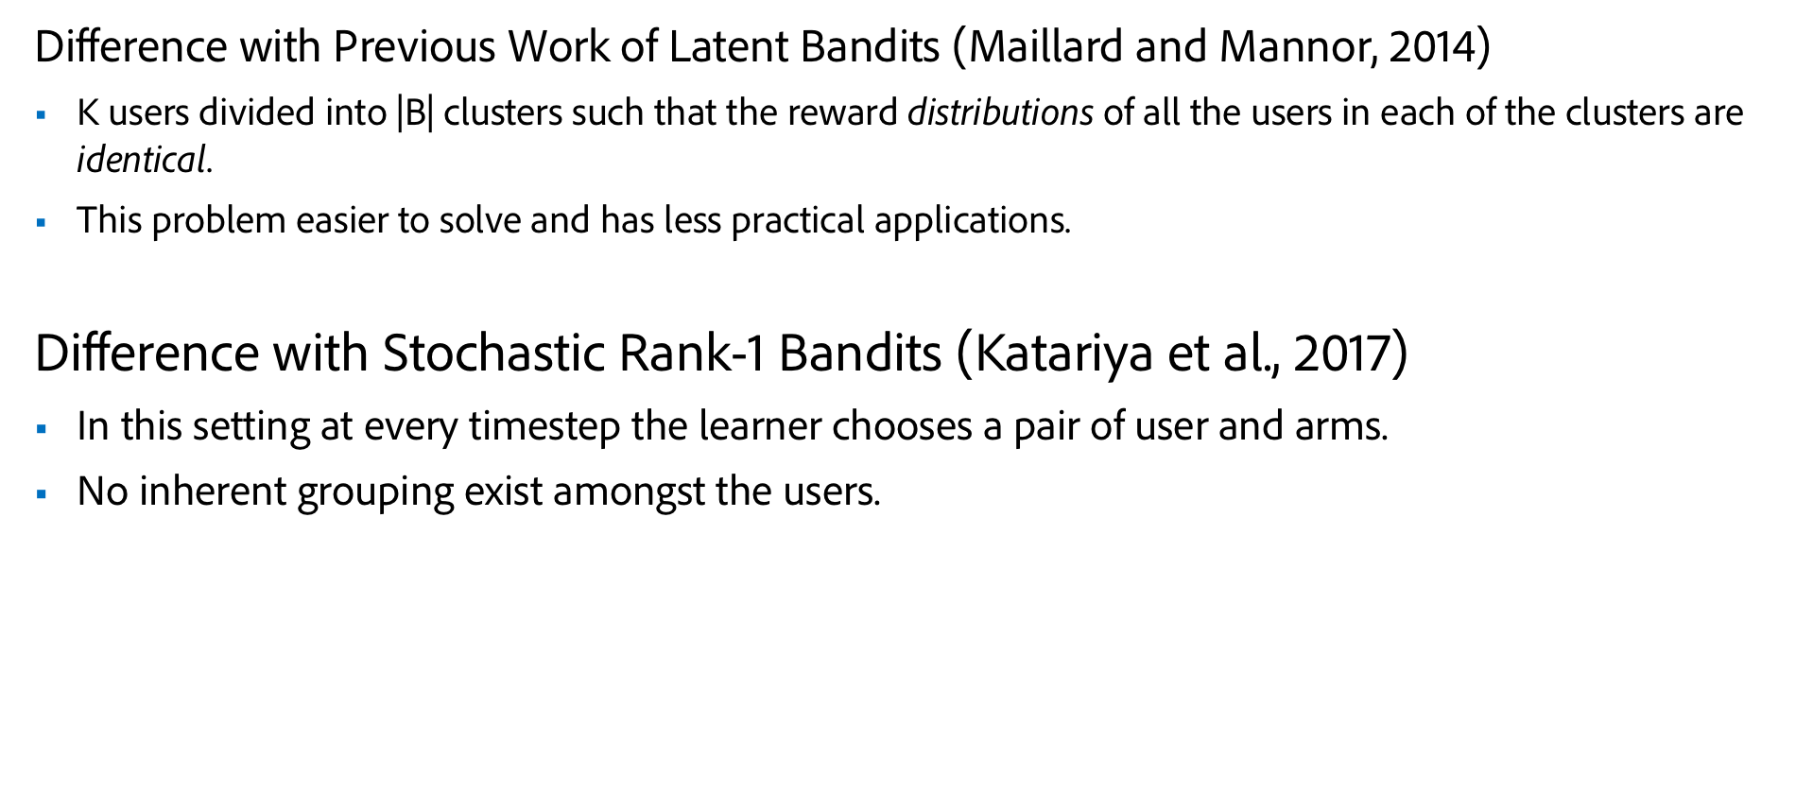
Related Works
Difference with Previous Work of Latent Bandits (Maillard and Mannor, 2014)
K users divided into |B| clusters such that the reward distributions of all the users in each of the clusters are identical.
This problem easier to solve and has less practical applications.
Difference with Stochastic Rank-1 Bandits (Katariya et al., 2017)
In this setting at every timestep the learner chooses a pair of user and arms.
No inherent grouping exist amongst the users.

Slide 8
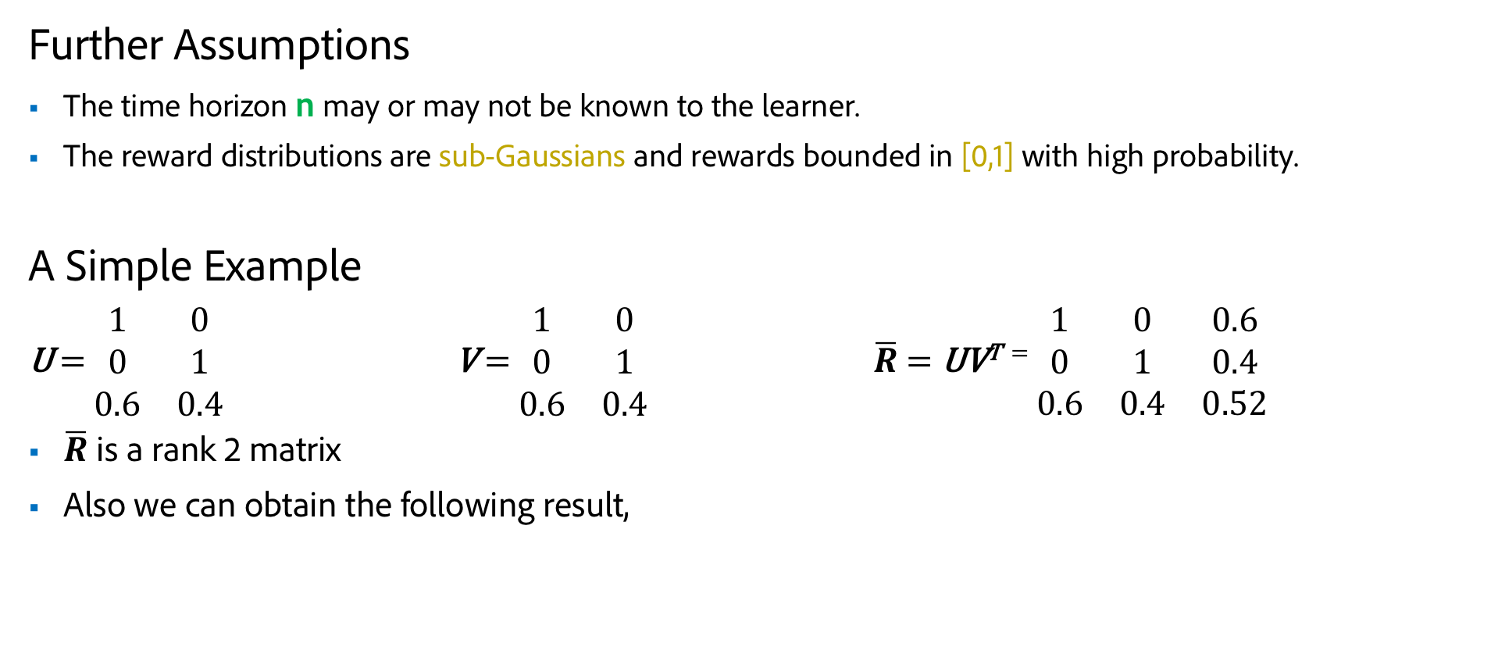
Assumption and Example
Further Assumptions
The time horizon n may or may not be known to the learner.
The reward distributions are sub-Gaussians and rewards bounded in [0,1] with high probability.
A Simple Example
U = $\begin{matrix}1 & 0 \\ 0 & 1 \\ 0.6 & 0.4\end{matrix}$ V = $\begin{matrix}1 & 0 \\ 0 & 1 \\ 0.6 & 0.4\end{matrix}$ $\overline{R}$ = UV^{T =} $\begin{matrix}1 & 0 & 0.6 \\ 0 & 1 & 0.4 \\ 0.6 & 0.4 & 0.52\end{matrix}$
$\overline{R}$ is a rank 2 matrix
Also we can obtain the following result,

Slide 9
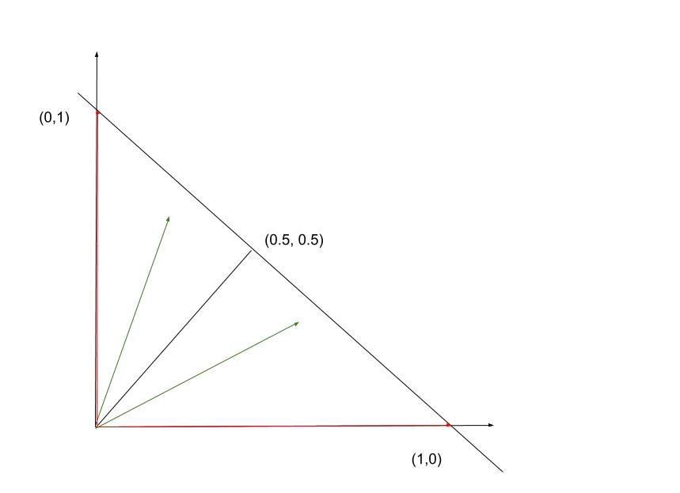

A Simple Example
$\overline{R}$ is a hott topics matrix.
The red vectors signifies the basis vectors.
The green vectors signifies other user vectors.

Slide 10
Academic & Industrial - Related Work
Relevant academic publications
Maillard O., Mannor S., (2014). Latent Bandits
Katariya, S., Kveton, B., Szepesvari, C., Vernade, C.,&Wen, Z. (2016). Stochastic Rank-1 Bandits. AISTATS 2017.
Katariya, S., Kveton, B., Szepesvari, C., Vernade, C.,&Wen, Z. (2016). Bernoulli Rank-1 Bandits for Click Data. IJCAI 2017.
Auer P., Ortner,& R. (2010). UCB Revisited: Improved Regret Bounds For The Stochastic Multi-Armed Bandit Problem. Periodica M.athematica Hungarica

Slide 11
Timeline
Week 1-3
Define problem statement
Literature review
Present Inception Talk
Week 4-6
Develop and analyze algorithm for the noise-free setting
Regret Upper Bound for the noise-free setting
Develop algorithm for the noisy setting
Week 7-10
Regret upper Bound for the noisy setting
Experiments with other state-of-the-art algorithms
Week 11-13
Prepare paper for submission (probably NIPS)

